Slide 1

BTEC Level 2 Information & Creative Technology Unit 2 – Technology Systems
Notes:
V1. BTEC Logo © Pearson Education Ltd. Intended for the Pearson BTEC Level 2 NQF Specification from 2012. This resource is in no way endorsed by Pearson.
Sample edition.

Slide 2

Learning aim a: Understand how the components of technology systems work together

Slide 3
Chapter 2 – issues of technology systems

Slide 4
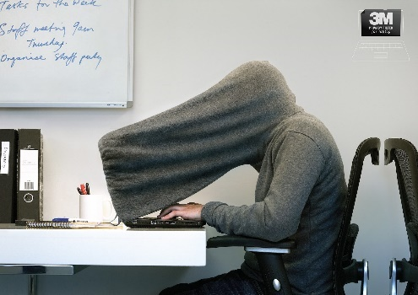
Risks to data
There are many risks to data:
Acts of nature (Natural disasters)
Data can be damaged in floods, fires, hurricanes, earthquakes etc.
Acts of crime
Computer misuse, hacking, phishing, spyware, shoulder-surfing, theft etc.
Accidental loss
Accidental deletion, physically losing mediums of storage such as memory sticks etc.
Technology failure
Power cuts, power surges, hard drive failure, software failure, file corruption etc.
Viruses & malware
Worms, Trojans, and Viruses…
Anti-shoulder surfing hoodie
Notes:
Acts of nature may also be called ‘acts of god’ or ‘natural disasters’. Image - http://theinspirationroom.com/daily/2012/3m-privacy-for-your-eyes-only/;

Slide 5
Viruses & malware
Virus
Viruses travel between devices via email attachments, networks, removable storage or internet downloads. Viruses attach themselves onto files which may then be transferred or stored on other devices. They can cause files to be destroyed and cause issues with software.
Think of the common cold, a type of bacterial virus, which is spread by the source (the human that sneezes!). The spread virus can be destroyed by anti-bac cleaners, but the source continues spreading.
Worm
Worms work in a similar way to viruses, however do not require a source file and therefore they can travel on their own. Worms can use file transfer systems and vulnerabilities in software that requires a ‘patch’.
Trojan
Trojans are pieces of software that are created for malicious uses. They can be transferred by being masked as a legitimate file which will then cause the operating system to malfunction (They cannot spread by themselves).
Trojans can also create routes for other Trojans and Worms to enter – these are called ‘backdoors’.

Slide 6
Data protection
Data can be protected in a number of different ways:
Real-world protection
CCTV (Closed Circuit Television), Security doors, Kensington locks and Biometric access
Anti-virus software
Software that removes viruses by scanning the hard drive and monitors new downloads
Basic backup
Backing up files onto external hard drives, flash sticks, optical disks and magnetic drives
Storing data off-site at different locations to protect against floods and fires
Cloud backup
Backing up files onto the cloud to protect against acts of nature, whilst allowing anytime access
Personal choices
Making sensible decisions such as not writing passwords down and ensuring nobody is ‘shoulder surfing’
Notes:
Im

Slide 7
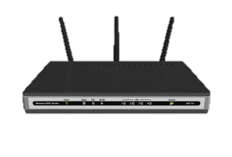



Introducing firewall
Another method of data protection is firewall, which is a security system put in place to monitor and restrict incoming (and outgoing) data packets before it reaches the network and connected devices
It acts as a security guard between the world wide web and a network (or stand alone PC)
This is the same as putting a lock on a door, it may not work all the time, but its still important
Firewalls are usually in the form of software, however in large data centres such as those storing all your files for Dropbox, a physical piece of hardware can be used
We can add in a firewall to the Internet access diagram. As you can see it sits between the internet and router:
Internet
Firewall
Router
Computer
Notes:
Globe - http://drainedapple.com/204/net-neutrality/ (coloured); Firewall - http://www.canstockphoto.com/illustration/firewall-icon.html (Coloured); Router - http://www.canstockphoto.com/illustration/router.html (Coloured); Computer - http://www.canstockphoto.com/illustration/ergonomic.html (coloured)

Slide 8
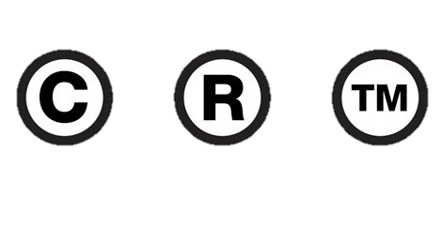
Laws & regulations
Computer Misuse act 1990
This law prevents computer crimes such as making and distributing viruses, accessing data and files without permission, changing data and files without permission and committing fraud or identity theft using the internet
Data protection act 1998
This law prevents data crimes such as sharing or keeping private data without owners permission or for financial gain, failing to keep information up to date, failing to sufficiently protect data
Copyright, Designs and patents act 1988
This law prevents people using, sharing, changing, copying or selling materials or designs that have a copyright, trademark or patent associated with them unless the person has permission from the owner(s). This law also covers activities outside an agreed licence (E.g. Selling a piece of music, provided for personal educational purposes only, for financial gain)
Copyright
Registered Trademark
Unregistered Trademark
Notes:
Symbols - http://imjustcreative.com/trademark-copyright-logo-design/2010/08/17/ (Coloured);

Slide 9
TalkTalk Case study
In October 2015 there were two cyber attacks on the website of TalkTalk; a broadband, landline and TV provider. During the attack, its thought that over 15,656 customers’ private details were obtained, including bank account details.
The hack left customers feeling very worried about their private information, and many of those affected began to receive bogus calls from scammer posing as TalkTalk or Microsoft staff in an attempt to gain access to their computers remotely.
One of the scams was to convince the customer they had a problem with their broadband connection or software and that they would be able to fix this for a fee of up to thousands
They would then convince the victim to allow remote access where they would open settings and commands to make it look like they were carrying out technical work, but in reality they were not
Once the data had been accessed, it is easy for the hackers to sell the data on to others who may use it for further scams or to attempt to gain further access to bank accounts
After long investigations, TalkTalk revealed that the data accessed was part encrypted and therefore the non-encrypted parts of bank details could not be used for financial gain
TalkTalk would not encrypt all of the data for security procedure use (ironically), for example when you are asked to confirm the last 4 digits of your bank card number
Since the hack, as of February 2016, its thought that over 101,000 customers left TalkTalk and the entire incident has cost the company as much as £80 million
Source: Sky News
Notes:
Information - http://news.sky.com/story/1582737/talktalk-157000-customers-hit-in-hack & http://news.sky.com/story/1583551/talktalk-customers-warned-over-scam-calls & http://news.sky.com/story/1634477/hack-sees-talktalk-lose-101000-customers;

Slide 10
Environmental impacts
Using computing technologies requires sources of electricity which is mainly from unrenewable resources (It’s also expensive!!)
E.g. Burning fossil fuels which can damage the environment and will one day run out
We can overcome this by using lower energy parts and switching to renewable sources
Another problem is the level of old computers and components going to landfill
As technology is moving faster than ever, products we have get replaced more quickly
We can reduce this impact by recycling or reusing our unwanted goods
As more people shop online, there are more vehicles on the road that deliver these goods
This causes more pollution in the air and more packaging being used to protect the products
We can reduce this by delivering to central points such as Amazon Lockers to reduce the amount of journeys couriers make, and then recycling the packaging goods arrive in
Can you think of any other environmental impacts? How can we reduce their impacts?

Slide 11

Social impacts
Technology may cause people to become anti-social and not go out as much
With popular social networking sites such as Facebook, people may not go out with friends as much as they used to
On the other hand, it allows us to stay in touch with long distance family and friends
Playing computer games can cause young people to become unhealthy
When children & teenagers are playing computer games they are not getting any exercise
However, there are smartphone apps and wearable tech to help monitor and encourage exercise
Many people believe that technology reduces the need for jobs – this is arguable
Technology may replace jobs such as self-checkout lanes in supermarkets
Technology may create jobs such as building and maintaining networks in a business
Watch the video on the next page…
Notes:
Globe - http://www.primap.com/wsen/Maps/MapCollection/WorldMaps/Globe-(Europe-centered)-Vegetation-4000x4000.html (Coloured);

Slide 12

Do technology systems take away jobs?
It is certainly a good debate and discussion to have as a class, and this clip from the Channel 4 prank series ‘FaceJacker’ may change your mind!
Click to play
Notes:
Video - https://www.youtube.com/watch?v=dPA-aog4fzg - Hat Trick & Channel 4 ©;

